Slide 1



PCGAN: Partition-Controlled Human Image Generation
Dong Liang*, Rui Wang*†, Xiaowei Tian, Cong Zou
Institute of Information Engineering, Chinese Academy of Sciences
School of Cyber Security, University of Chinese Academy of Sciences

Slide 2
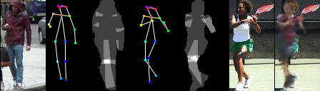
Goal
Source image
Target image
Transfer the person in the source image to the pose and background in the target image.

Slide 3
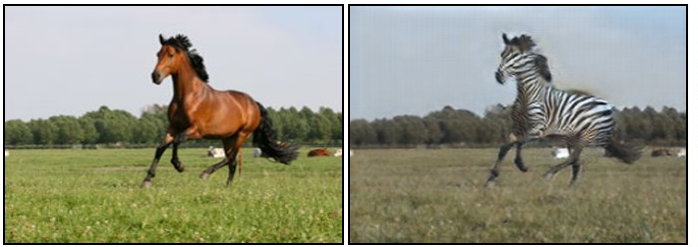
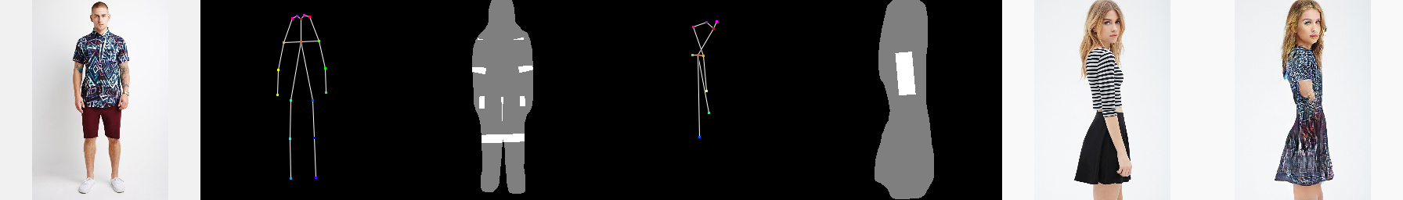
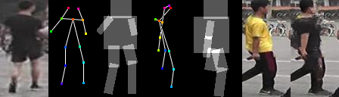
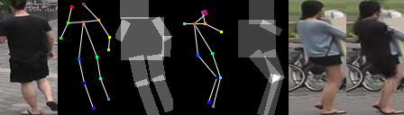
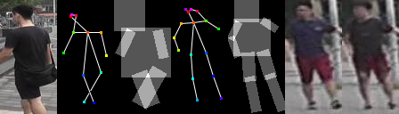
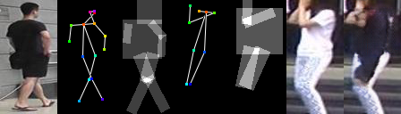
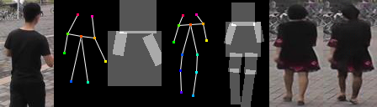
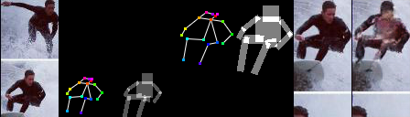
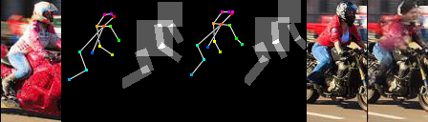
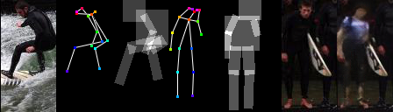
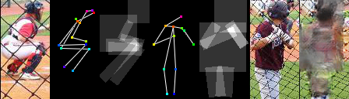
Challenges
Low tolerance rate for flaws in the human images;
Complex surrounding background;
Large spatial transformations.

Slide 4
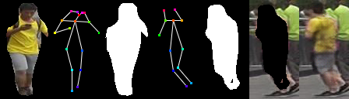
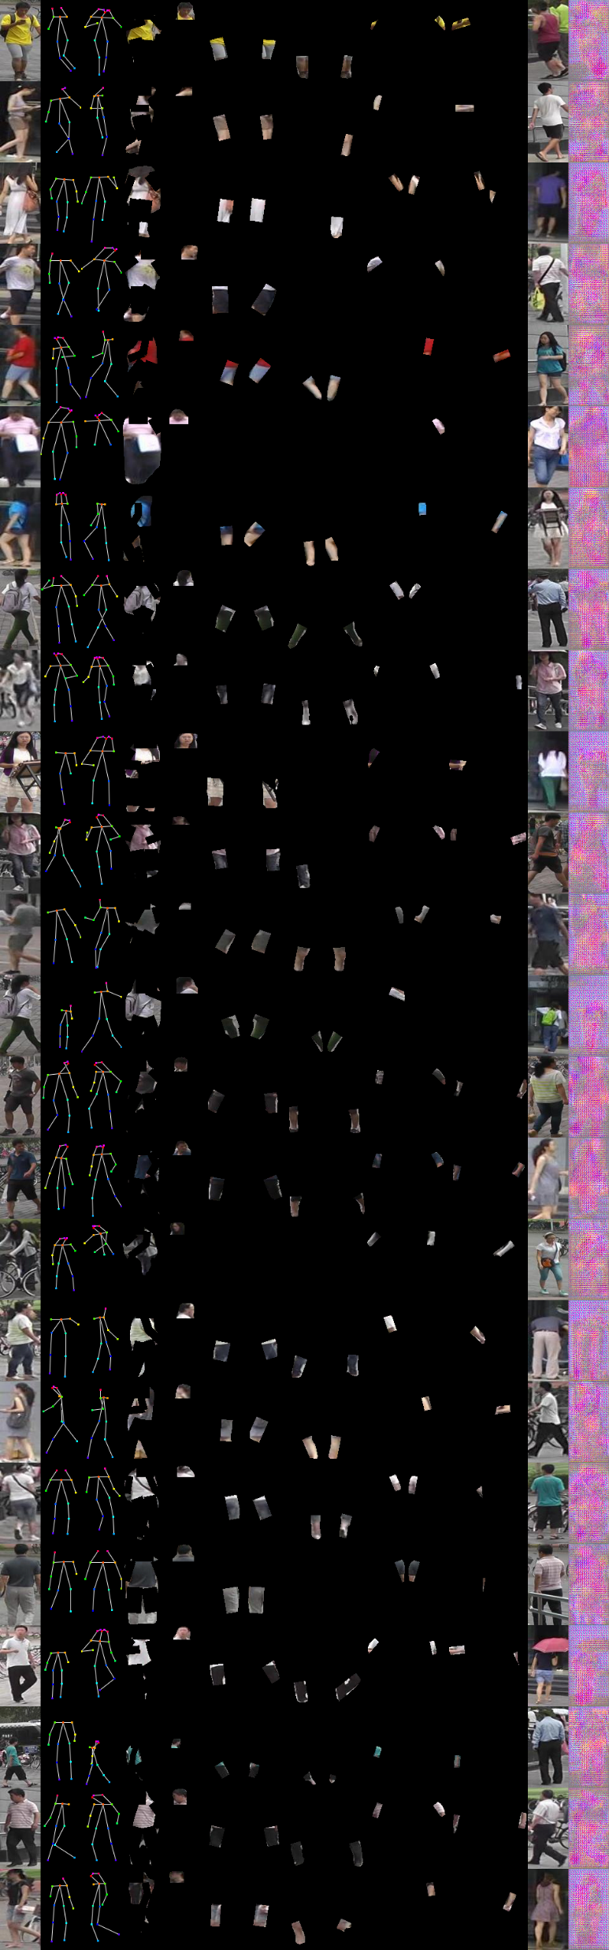
Observations
Human image can be partitioned into several parts.
Partition the image into foreground and background.
Partition the body sub-parts of the foreground person.

Slide 5
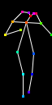

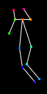

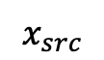
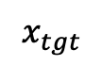
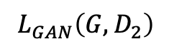
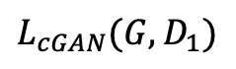
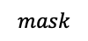
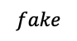
Partition-Controlled Human Image Generation
Fake
or
Real
$$L_{cGAN}(G,D_{1})$$
$$x_{src}$$
$$mask$$
$$fake$$
Fake
or
Real
$$L_{GAN}\left(G,D_{2}\right)$$
$$x_{tgt}$$
Generator
Discriminator

Slide 6
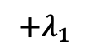
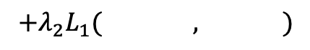
Partition-Controlled Human Image Generation
Fake
or
Real
$$L_{cGAN}(G,D_{1})$$
$$x_{src}$$
$$mask$$
$$fake$$
Fake
or
Real
$$L_{GAN}\left(G,D_{2}\right)$$
$$x_{tgt}$$
Generator
Discriminator
$$+λ_{2}L_{1}( , )$$
$$L=\min_{G}{\max_{D}{ }}$$
$$+λ_{1}$$

Slide 7

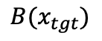
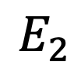

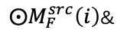


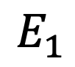
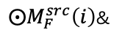
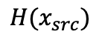
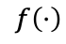


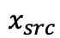


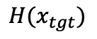
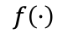
Generator: W-Net
$$x_{src}$$
$${H(x}_{src})$$
$$\hat{x}$$
$${B(x}_{tgt})$$
$${H(x}_{tgt})$$
$$feat(E_{1}_1)$$
$$feat(D_5)$$
$$feat(E_{2}_1)$$
$⨀M_{F}^{src}\left(i\right)$&
$$f\left(⋅\right)$$
…
…
$$E_{1}$$
$$D$$
$$E_{2}$$
$$feat(E_{1}_6)$$
noise
$$feat(E_{2}_6)$$
$⨀M_{F}^{src}\left(i\right)$&
$$f\left(⋅\right)$$

Slide 8

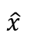
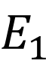
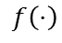

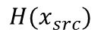
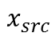


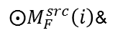

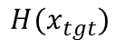
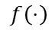
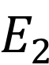

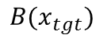
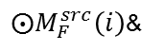
Generator: W-Net
$$x_{src}$$
$${H(x}_{src})$$
$$\hat{x}$$
$${B(x}_{tgt})$$
$${H(x}_{tgt})$$
$$feat(E_{1}_1)$$
$$feat(D_5)$$
$$feat(E_{2}_1)$$
$⨀M_{F}^{src}\left(i\right)$&
$$f\left(⋅\right)$$
…
…
$$E_{1}$$
$$D$$
$$E_{2}$$
$$feat(E_{1}_6)$$
noise
$$feat(E_{2}_6)$$
$⨀M_{F}^{src}\left(i\right)$&
$$f\left(⋅\right)$$

Slide 9
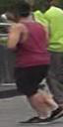

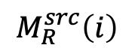
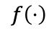
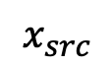
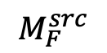










Human Body Transformation
$$f\left(⋅\right)$$
$$⨀$$
$$x_{src}$$
$$x_{tgt}$$
$$P\left(x_{src}\right)$$
$$M_{R}^{tgt}$$
$$M_{R}^{src}$$
$$M_{F}^{src}$$
$$x_{src}$$
$$M_{R}^{src}$$
$$M_{R}^{tgt}\left(i\right)$$
$$M_{R}^{src}\left(i\right)$$
$$f\left(⋅\right)$$
$$⨀M_{F}^{src}\left(i\right)$$
$$f\left(⋅\right)$$
Body sub-parts

Slide 10

Compared with the state-of-the-art

Slide 11





Compared with the state-of-the-art
$$x_{src}$$ | $$x_{tgt}$$ | Ma et al. 2017 | Ma et al. 2018 | Def. GAN | PCGAN

Slide 12
































Ablation study
LIP
COCO2017
Market-1501
$$x_{src}$$
$$x_{tgt}$$
Baseline
R-Mask
Full
$x_{src}$ | $$x_{tgt}$$ | Baseline | R-Mask | Full
$x_{src}$ | $$x_{tgt}$$ | Baseline | R-Mask | Full

Slide 13











Result visualization– Market1501
$$x_{src}$$
$$x_{tgt}$$
Results

Slide 14








Result visualization - DeepFashion
$$x_{src}$$
$$x_{tgt}$$
Results

Slide 15











Result visualization – COCO2017
$$x_{src}$$
$$x_{tgt}$$
Results

Slide 16










Result visualization - LIP
$$x_{src}$$
$$x_{tgt}$$
Results

Slide 17


Failure cases
Errors in HPE when given pose landmarks.
The mask region is so large that it cannot cover the expected body part.

Slide 18

Q & A.
https://github.com/AlanIIE/PCGAN

